Slide 2
Nanopore sequencing
Mikael Lenz Strube (milst@dtu.dk)

Slide 3
Recap!

Slide 4
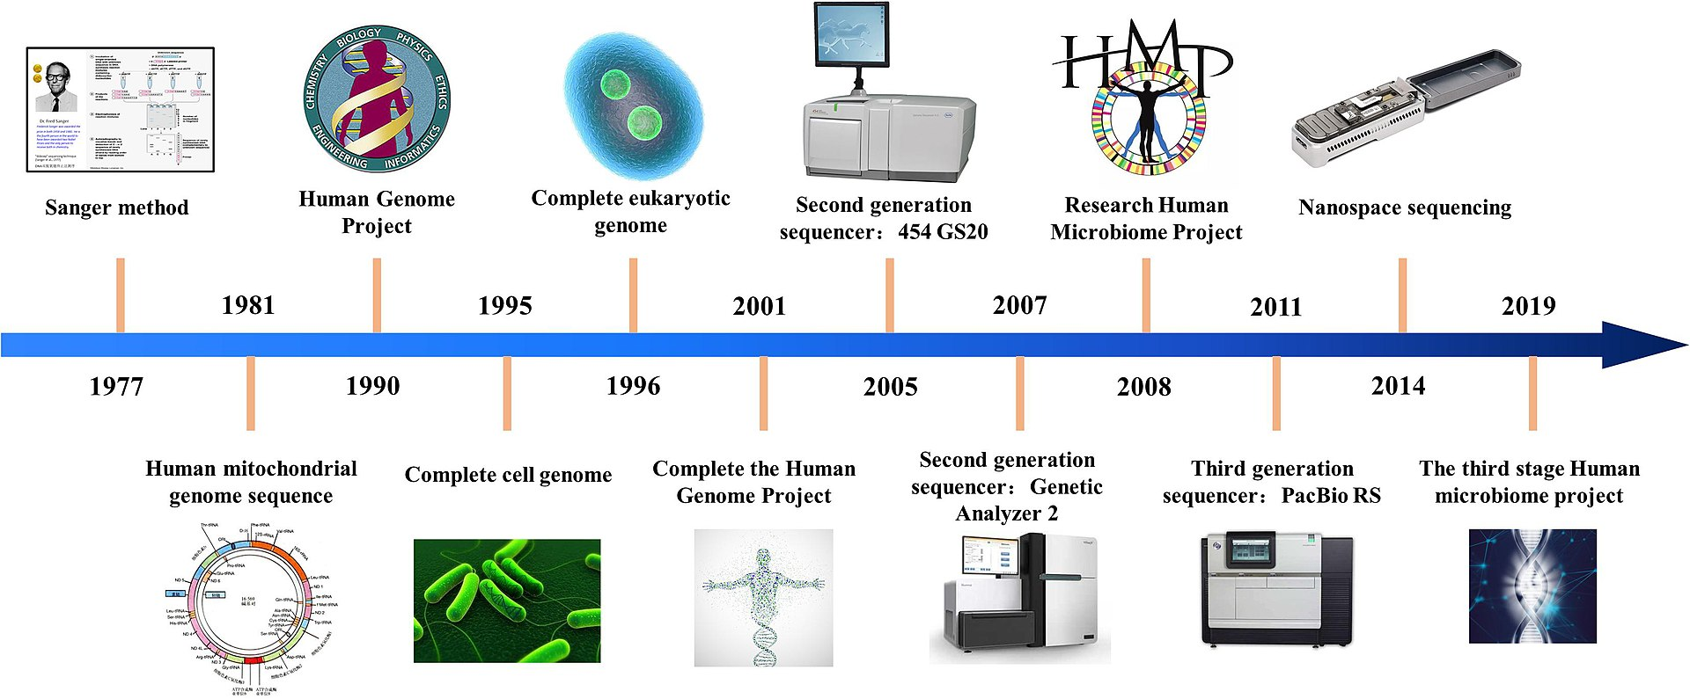
Nanopore The history
2nd gen
~milions
200-500bp
3rd gen
~milions
>milions bp
1st gen
1 seq
~1000bp

Slide 5
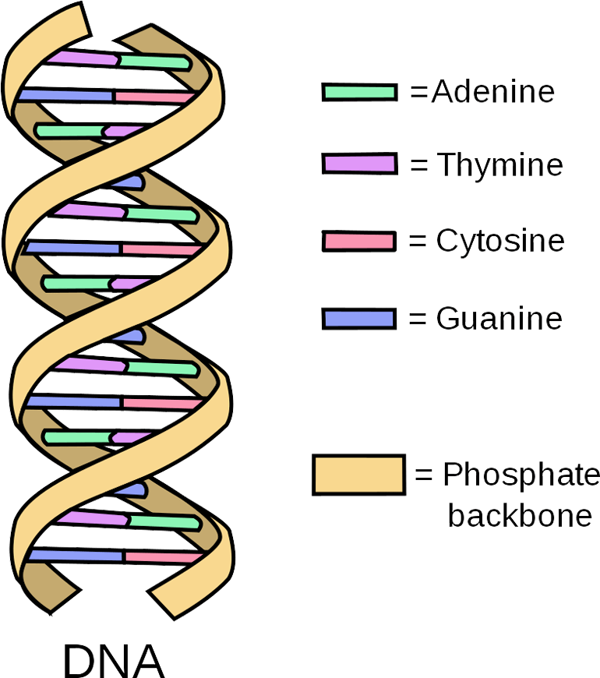
Nanopore The concept
AGCTAAGTCGAT….

Slide 6
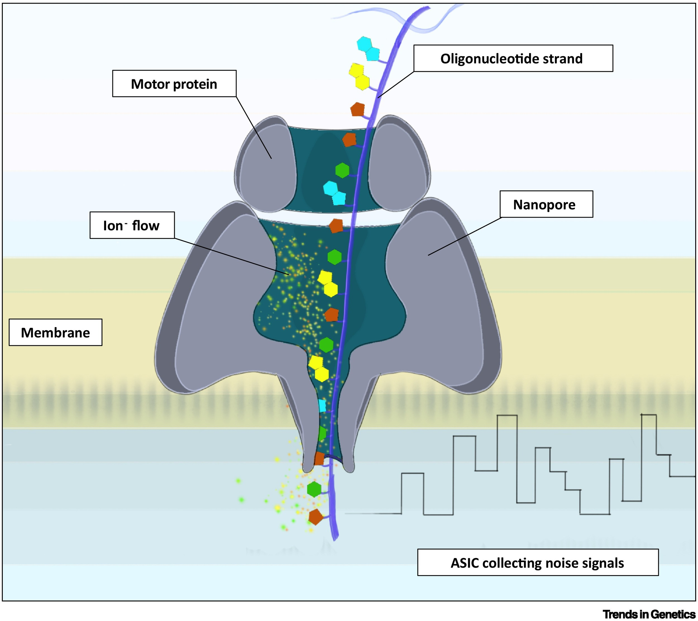
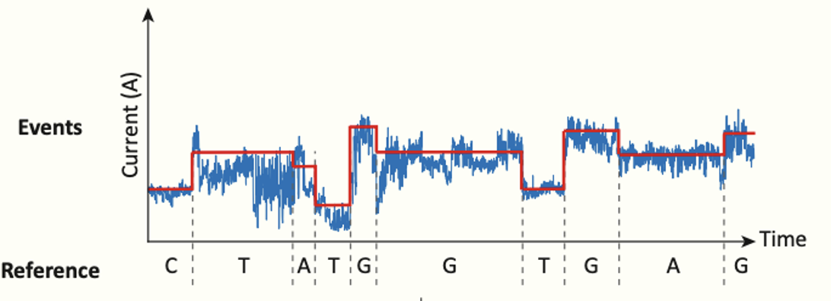
Nanopore The concept

Slide 7
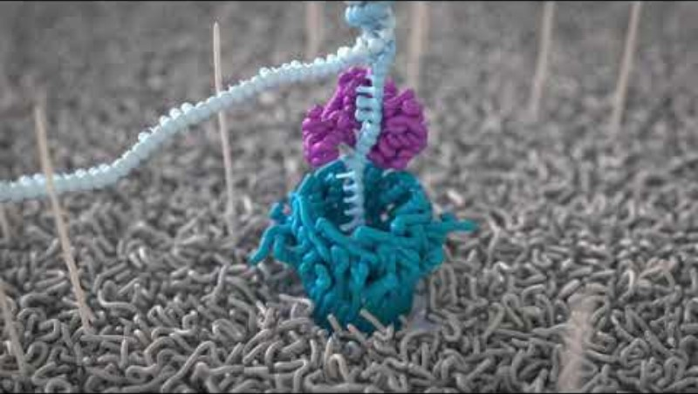
Nanopore The concept

Slide 8
Nanopore Usage

Slide 9
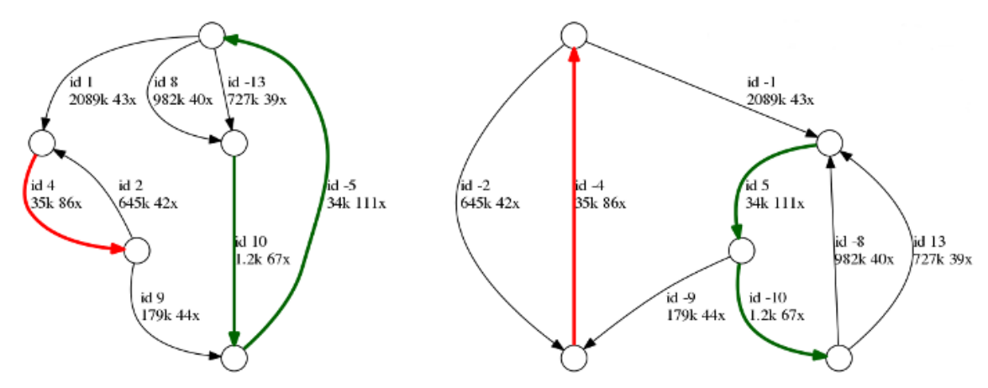
Nanopore Assembly

Slide 10
Nanopore sequencing
Mikael Lenz Strube (milst@dtu.dk)

